Slide 1
Cyclistic Bike-Share Membership Analysis
How Does a Bike-Share Navigate Speedy Success?
Notes:
This analysis was carried out to provide insights into the behavior of current annual memberships. Understanding why member types of annual memberships were favored will inform Cyclistic's marketing strategy that aligns with the company goal to maximize the number of annual memberships.

Slide 2
Data
Previous 12 months covering covering December 2021 to November 2022 direct from Cyclistic website
Limitations
Unable to connect pass purchases.
Lack of knowledge on docking stations issues.
Notes:
Connecting pass purchases to credit card numbers to determine if casual riders live in the Cyclistic service area, or if they have purchased multiple single passes was not available for analysis in line with PII privacy standards.
Further analysis of trip length needs to be carried out. Query with Cyclistic: do the docking stations fault sometimes? This could explain ride times of 0 seconds, and higher ride length time over days in length.

Slide 3
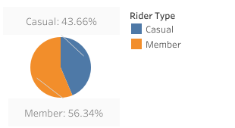
Riders by Type
Members currently take up a slight
majority in membership type.

Slide 4
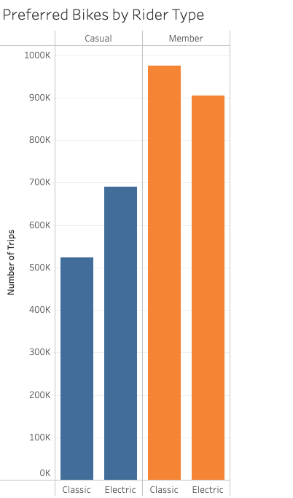
Bike Preference by Rider
The preference for bike type of our members
is the classic bike.
Electric bikes are chosen as a preference
for our casual users.

Slide 5
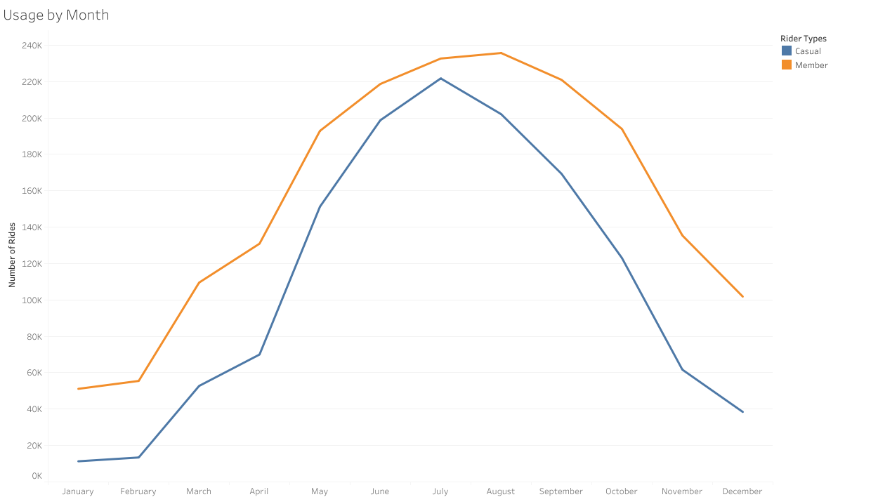
Usage by Month
We see a real climb in usage
in summer months across both
types of riders

Slide 6
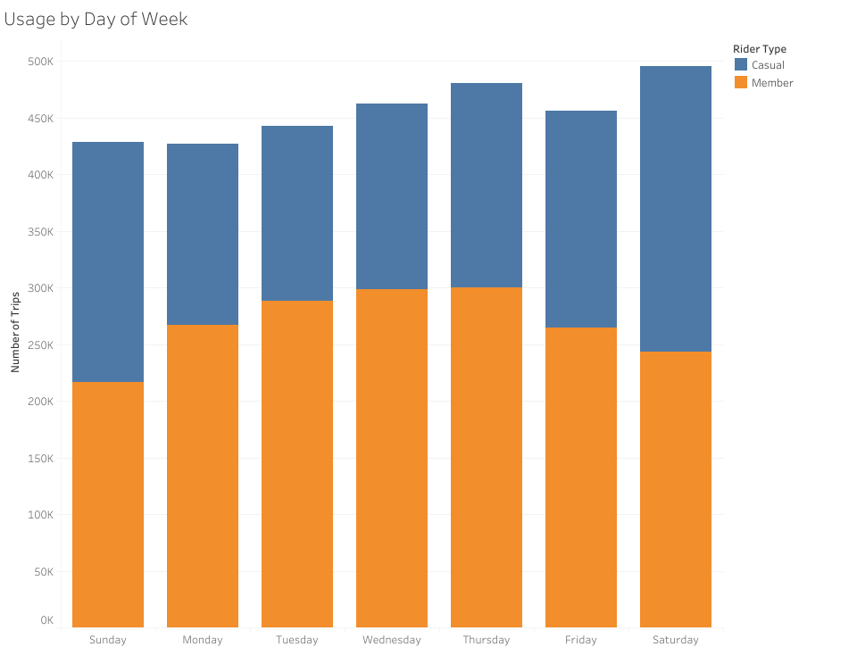
Usage by Day of Week
Notes:
See that weekdays are more popular for members, and weekends more popular for casual users

Slide 7
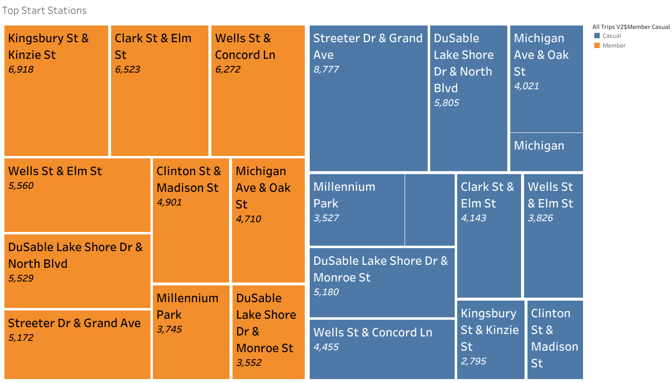
Top Start Stations

Slide 8
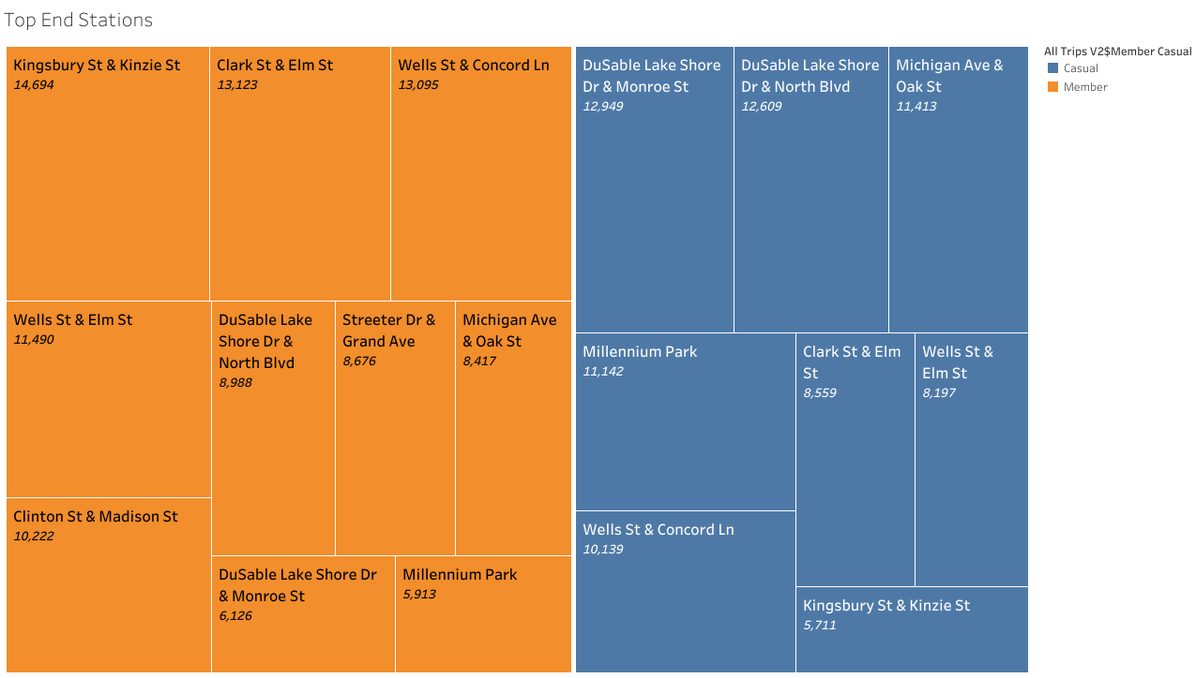
Top End Stations

Slide 9
Recommendations
Look into attrition rates. Are we losing or gaining annual memberships?
Cost Analysis for Electric Bikes Pilot Scheme
Segment casual riders into tourists and non-tourists for more targeted marketing
Notes:
Start looking at historical data to compare attrition rate YoY. Is annual membership growing? Have any conversion campaigns been carried out in the past? Have they been a successful, a failure?
Run a pilot by offering discounted electric bike memberships at the same price of classic bike memberships for the first year. Test if there is a cost barrier for casual riders to convert to members but preference electric bikes but can’t justify the cost of having an electric bike membership for annual use.
It would also be important to understand how many of the casual riders are tourists. Looking at the heat maps, it’s evident that the most popular stations for casual riders are located in top tourist locations. This compounded by the fact that weekends are also the most popular days for casual riders, may need us to understand what level of casual users are tourists. Segmenting the casual user base into tourist and local riders, will allow for more targeted marketing.

